Slide 1
CSE495B (Natural Language Processing) Lecture 6
Word Embedding: Word2Vec

Slide 2
What is a word?
We already covered it in the previous lectures
An idea
Represented by the word or the phrase
A person wants to express by using that word or the phrase
That is expressed in a work of writing, art, etc.
But all those are for human
How does a computer interpret words?
It cannot…
We need a representation
2

Slide 3
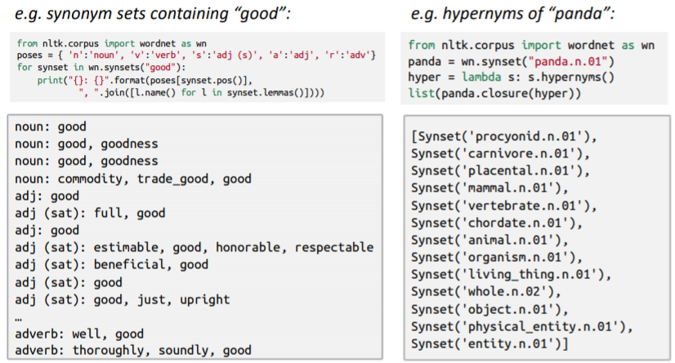
WordNet: Human made thesaurus
WordNet helps computers understand words w.r.t. words
A thesaurus containing lists of synonyms sets and hypernyms (“is a” relationships) and some others

Slide 4
Problems with WordNet
Great as a resource but missing nuance
“proficient” is listed as a synonym for “good”
This is only correct in some contexts
Missing new meanings of words
Wicked, nifty, wizard, genius, ninja, bombast
Impossible to keep up-to-date
Subjective
Requires human labor to create and adapt
Can’t compute accurate word similarity

Slide 5

Representing words as discrete symbols
In traditional NLP, we regard words as discrete symbols
Hotel, motel, conference room - all are separate
Words can be represented by one-hot/weighted-frequency vectors
Vector dimension = number of words in vocabulary

Slide 6

Problems with words as discrete symbols
If someone wants to search for “hotel in Dhaka”, we would also like to match documents containing “motel” & “Dhaka”
But
These two vectors are orthogonal
There is no natural notion of similarity for one-hot vectors
Solution
Could try to rely on WordNet’s list of synonyms to get similarity
Instead: learn to encode similarity in the vectors themselves

Slide 7
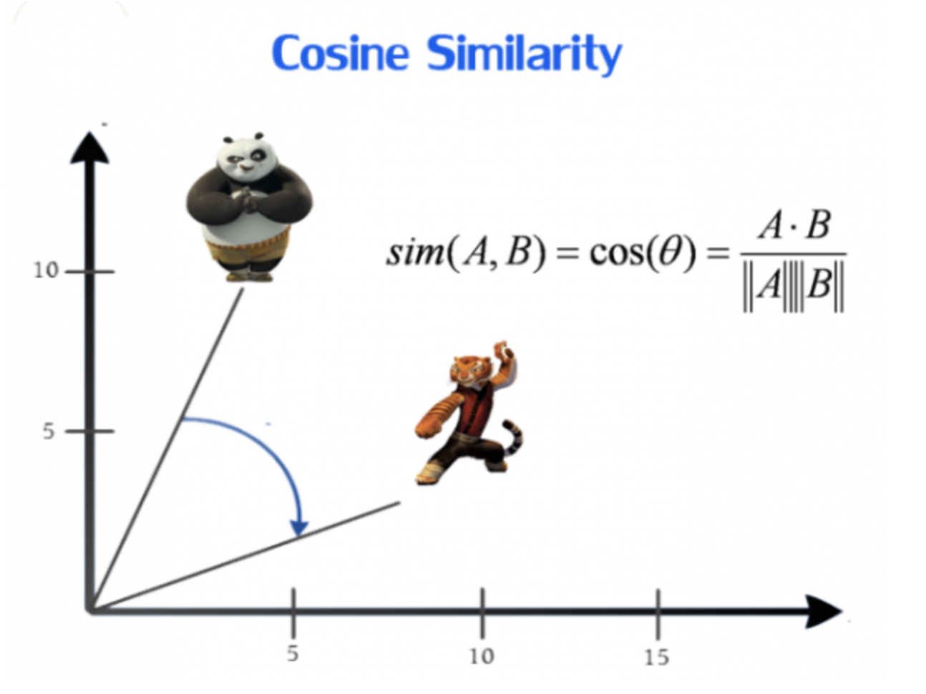
Similarity measurements for one-hot vectors
Here comes the idea of generating distributed representations
Intuitively, we introduce some dependence of one word on the other words
The words in the context of this word would get a greater share of this dependence
In one hot encoding representation, all the words are independent of one another
Their similarity is 0

Slide 8
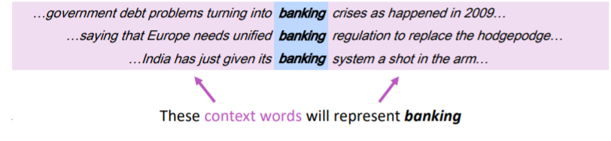
Representing words by their context
Distributional semantics: A word’s meaning is given by the words that frequently appear close-by
“You shall know a word by the company it keeps”
One of the most successful ideas of modern statistical NLP
When a word 'w' appears in a text, its context is the set of words that appear nearby (within a fixed-size window)
Use the many context of w to build up a representation of w

Slide 9
Word Embeddings are Dense Vectors
Word embeddings map individual words to real-valued vectors in a predefined vector space
Each word corresponds to one vector, and these vector-values are learned using neural networks
The central idea is to use a dense, distributed representation for each word, typically spanning tens or hundreds of dimensions
This contrasts sparse word representations (like one-hot encodings) that require thousands or millions of dimensions

Slide 10
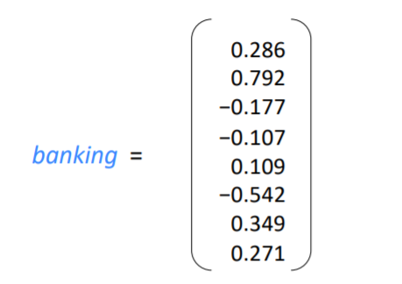
Word vectors/embeddings
We want to find vectors representing words
And, we want the vectors to capture the context
We can do this by using word embeddings
They are distributed representation words
One popular example is word2vec

Slide 11
Word2vec
Word2Vec is a method to construct such an embedding
Word2Vec uses a special kind of neural network: auto-encoder
A simple neural network with a single hidden layer will be trained to perform a specific task—but interestingly, it will not actually be used for the task it was trained on.
Instead, the objective is to learn the weights of the hidden layer, which will turn out to be the very “word vectors” we aim to obtain.

Slide 12
What do we expect from Word2Vec
We’re going to train the neural network to do the following:
Given a target word (the word in the middle of a sentence), sample one of its surrounding words at random (context).
The network outputs a probability for every vocabulary word being that sampled “context” word.
These probabilities reflect how likely each vocabulary word is to appear near the target word.
For example, if we gave the trained network the input word “Soviet”, the output probabilities are going to be much higher for words like “Union” and “Russia” than for unrelated words like “watermelon” and “kangaroo”

Slide 13
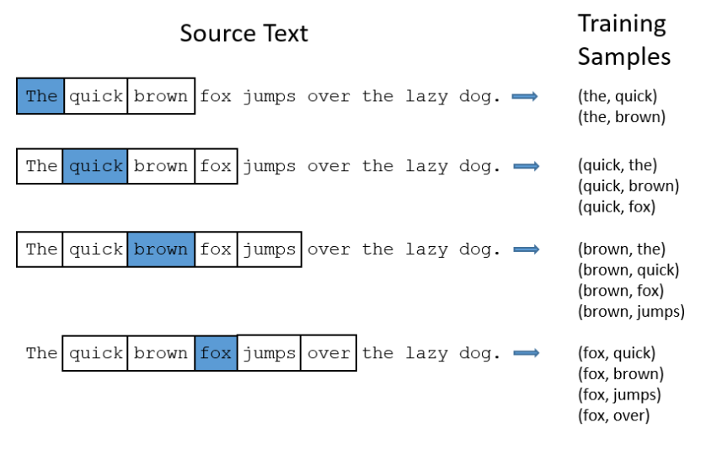
Training word2vec

Slide 14
Training word2vec
The network is trained on (target, context) word pairs extracted from the training corpus.
For each sentence, we slide a window around each target word and pair it with nearby words. (A window size of 5 here means up to two words on either side, as available.)
The previous slide illustrates pairs taken from “The quick brown fox jumps over the lazy dog.”
In the figure, the blue word is the input/target word; the words within the window are its context.

Slide 15
Training word2vec
The network learns from how often word pairs co-occur in the corpus.
Common pairs generate many training examples; rare pairs generate few.
For instance, (“Soviet”, “Union”) will appear far more often than (“Soviet”, “Sasquatch”).
After training, given the input “Soviet,” the model assigns much higher probability to “Union” or “Russia” than to “Sasquatch,” reflecting these observed co-occurrence patterns.

Slide 16
Autoencoder Model
Neural networks can’t read raw text, so words must be converted to numeric vectors.
Build a vocabulary from the corpus—say 10,000 unique words.
Represent each input word (e.g., “Soviet”) as a one-hot vector of length 10,000: all zeros except a single 1 at the index for “Soviet.”
The network outputs a single 10,000-dimensional vector of probabilities—one entry per vocabulary word—indicating how likely each word is to be a randomly chosen context word near the input.
The next slide illustrates this network architecture.

Slide 17
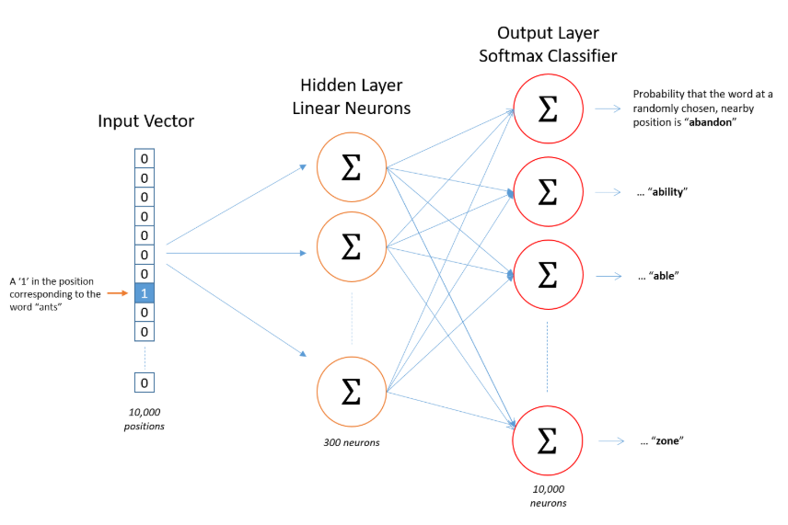
Autoencoder to learn word2vec embeddings

Slide 18
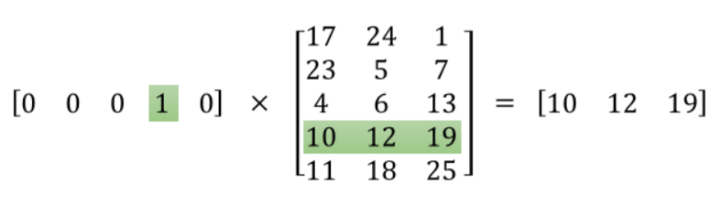
Weight lookup table
The true objective is to learn the hidden-layer weight matrix (the output layer will be discarded afterward).
Because an input is a one-hot vector (almost all zeros), multiplying a 1X10000 one-hot vector by a 10000X300 weight matrix simply selects the single row corresponding to the “1.”
In other words, the hidden layer just looks up the 300-dimensional row for the input word—this row is the word’s embedding (its “word vector”).
Therefore, the hidden layer functions as a lookup table for embeddings; training adjusts this table so that semantically related words get similar vectors.

Slide 19
The Output Layer
The 1 x 300 word vector for the words then are fed to the output layer
The output layer is a softmax regression classifier
Each output neuron (one per word in our vocabulary!) will produce an output between 0 and 1, and the sum of all these output values will add up to 1.
Specifically, each output neuron has a weight vector which it multiplies against the word vector from the hidden layer, then it applies the function exp(x) to the result
Finally, to get the outputs to sum up to 1, we divide this result by the sum of the results from all 10,000 output nodes.

Slide 20
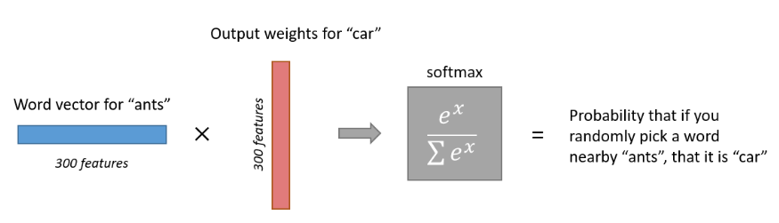
The Output Layer

Slide 21
Intuition: Why does this work
If two different words have very similar “contexts” (that is, what words are likely to appear around them), then this model needs to output very similar results for these two words
And one way for the network to output similar context predictions for these two words is if the word vectors are similar
So, if two words have similar contexts, then this network is motivated to learn similar word vectors for these two words
And what does it mean for two words to have similar contexts?
Maybe –synonyms like “intelligent” and “smart” would have very similar contexts.
Or that words that are related, like “engine” and “transmission”, would probably have similar contexts as well
This can also handle stemming– the network will likely learn similar word vectors for the words “ant” and “ants” because these should have similar contexts

Slide 22
Word2Vec issues
Note that neural network does not know anything about the offset of the output word relative to the input word
It does not learn a different set of probabilities for the word before the input versus the word after
To understand the implication, let's say that in our training corpus, every single occurrence of the word 'York' is preceded by the word 'New'. That is, at least according to the training data, there is a 100% probability that 'New' will be in the vicinity of 'York‘
However, in general, if we take the 10 words in the vicinity of 'York' and randomly pick one of them, the probability of it being 'New' is not 100%

Slide 23
Optimization
Here we had word vectors with 300 features, and a vocabulary of 10,000 words
The neural network had two weight matrices–a hidden layer and output layer
Both layers would have a weight matrix with 300 x 10,000 = 3 million weights each!
Running gradient descent on a neural network that large is going to be slow
Well, it was true 2013 but not anymore, still we need to know the optimizations
And to make matters worse, we need a huge amount of training data to tune that many weights and avoid over-fitting
Millions of weights times billions of training samples means that training this model is going to be difficult

Slide 24
Optimizations
The authors of Word2Vec addressed these issues in their second paper with the first two optimizations:
Subsampling frequent words to decrease the number of training examples
Modifying the optimization objective with a technique they called “Negative Sampling”, which causes some training sample to update only a small percentage of the model’s weights
Hierarchical softmax (not by the original word2vec authors)

Slide 25
Subsampling
There are two “problems” with common words like “the”:
When looking at word pairs, (“fox”, “the”) doesn’t tell us much about the meaning of “fox”. “the” appears in the context of pretty much every word.
We will have many more samples of (“the”, …) than we need to learn a good vector for “the”.
Word2Vec implements a “subsampling” scheme to address this
The probability that a word is removed is related to the word’s frequency.
For a window size of 10, and we remove a specific instance of “the” from our text:
As we train on the remaining words, “the” will not appear in any of their context windows.
We’ll have 10 fewer training samples where “the” is the input word.

Slide 26
Negative Sampling
When training the network on the word pair (“fox”, “quick”), recall that the “label” or “correct output” of the network is a one-hot vector. That is, for the output neuron corresponding to “quick” to output a 1, and for all the other thousands of output neurons to output a 0.
With negative sampling, we are instead going to randomly select just a small number of “negative” words (let’s say 5) to update the weights for. (In this context, a “negative” word is one for which we want the network to output a 0 for)
We will also still update the weights for our “positive” word (which is the word “quick” in our current example).
The output layer of our model has a weight matrix that’s 300 x 10,000
So we will just be updating the weights for our positive word (“quick”), plus the weights for 5 other words that we want to output 0
That’s a total of 6 output neurons, and 1,800 weight values total. That’s only 0.06% of the 3M weights in the output layer!
In the hidden layer, only the weights for the input word are updated
This is true whether we are using Negative Sampling or not

Slide 27
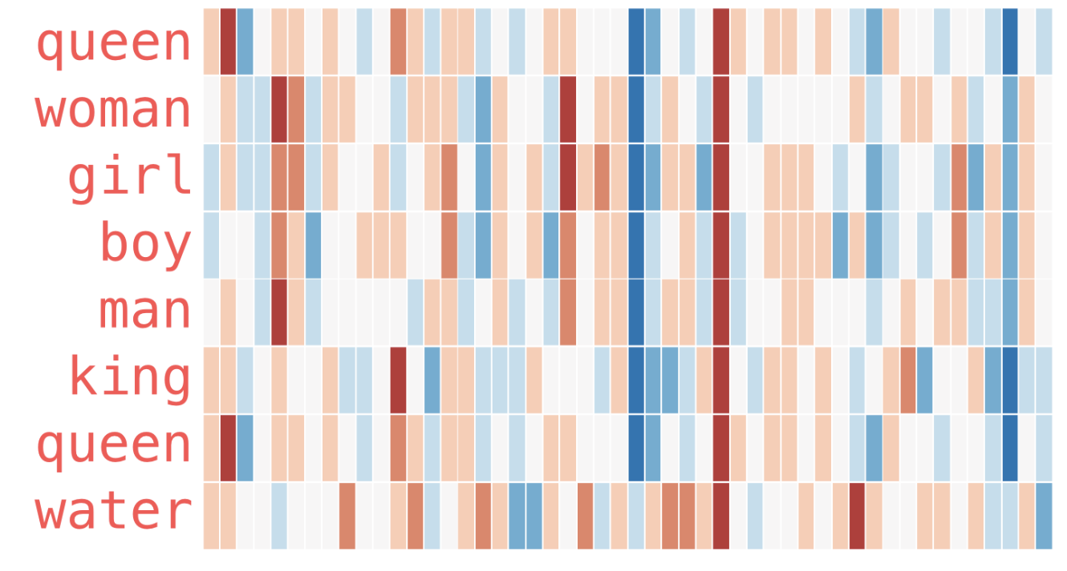
Word2vec context

Slide 28
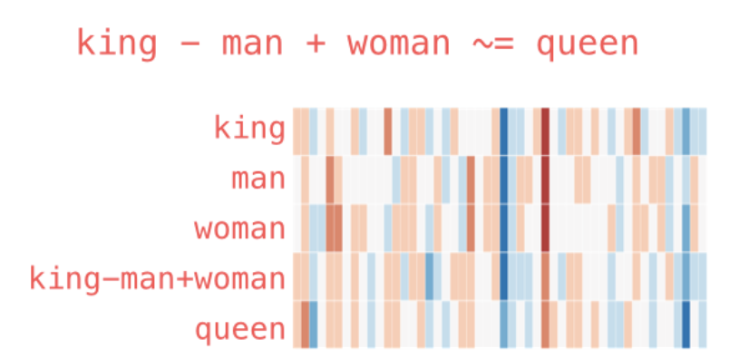
Word2vec context

Slide 29
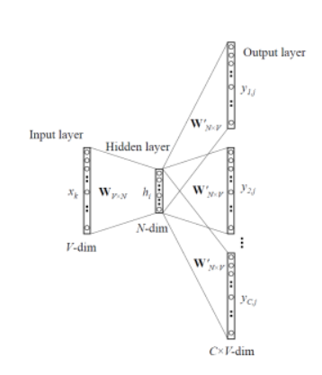
Skip-gram model for generating vectors
For skip-gram, the input is the target word, while the outputs are the words surrounding (context)
For example, in the sentence “I have a cute dog”, the input would be “a”, whereas the outputs are “I”, “have”, “cute”, and “dog”, when the window size is 5
All the input and output data are of the same dimension and one-hot encoded

Slide 30
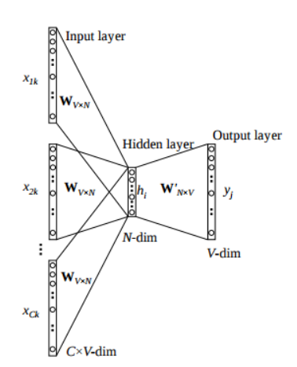
CBOW model for generating vectors
Continuous Bag of Words (CBOW) is very similar to skip-gram, except that it swaps the input and output
The idea is that given a context, we want to know which word (target) is most likely to appear in it

Slide 31
Skip-gram vs CBOW
Skip-gram and CBOW differ in processing the input
For CBOW, all the context words are fed into the network and an average of the activation values are passed to the next stage
For skip-gram, only the target word is fed to the network input while context words are expected as output
The dimensions of the hidden layer and the output layer are the same for both models
However there are some changes in the auto-encoder computations. If we have 4 target words, we will compute in the following way:
For 4 context words, we will have 4 1xV input vectors
Each will be multiplied with the VxE hidden layer producing 1xE vectors
All 4 1xE vectors will be averaged element-wise to obtain the final activation which then will be fed into the softmax layer
It is claimed that Skip-gram tends to do better in rare words. Nevertheless, the performance of Skip-gram and CBOW are generally similar.

Slide 32
Fasttext
Each word is represented as a bag of character n-grams
A vector representation is associated with each character n-gram
Words being represented as the sum of these representations
Vectors found for the sub-words are added to get the vectors for the main word
The original embedding dimension was 300 and was trained using wiki datasets
They used negative sampling for optimization
Performance is not significantly better than the Word2Vec
FastText originally used the skipgram model for training

